Slide 1
Doctor Appointment And Recommendation System
Ankit Budhathoki 15454
Ashbin Thapa 15455

Slide 2
Presentation Overview
Introduction
Problem Definition
Objective
Literature Review
Methodology
Tools Used
Working Schedule
Conclusion

Slide 3
Introduction
Doctor Recommendation System is developed to override the problems prevailing in the practicing manual system
System is designed for the particular need of the company to carry out operations in a smooth and effective manner
No formal knowledge is required for the users to use this system which makes it more user-friendly
Assist the users to concentrate on their other activities rather to rather to concentrate on the patient’s record keeping

Slide 4
Problem Definition
Inefficient and time-consuming process of scheduling medical appointments.
Long waiting times and have difficulty getting in touch with medical professionals for follow-up by patients
Challenge of managing their busy schedules, tracking patient appointments, and accessing patient information in a timely and accurate manner by Medical Professionals

Slide 5
Objective
To provide the searching facilities based on various factors such as doctor, patient, booking and doctor Schedule
To increase efficiency of managing the records of doctors and patients.
To enhance the recommendation model using collaborative filtering.

Slide 6
Literature Review
Although the conceptualization of doctor recommendation and appointment system is in initial phase, there are multiple literature showcasing the use collaborative filtering for recommendation in various aspects:
Better Doctor.[1] is an online platform that allows patients to search for healthcare providers and book appointments with them. The platform uses data from government and healthcare sources to provide accurate and up-to-date information about healthcare providers.
Health grades.[2] is an online platform that allows patients to search for and review healthcare providers based on their specialty, location, and patient reviews. Patients can also book appointments with healthcare providers through the platform
Notes:
Crop Management
• Water Monitoring
• Soil Monitoring (pH, Humidity, Salinity, Temperature)
• Crop Monitoring (Pest Detection, Photosynthesis, Weed Detection)
• Disease Prediction
Livestock Monitoring
• Disease Prediction
• Location Tracking
Remote Sensing
• Field Monitoring
• Unmanned Aerial Vehicle (UAV)
• Weather Monitoring
Supply Chain Management
• benefiting from agriculture marketing where Farmers can use the facilities of smart agriculture for selling their product directly to the consumer.

Slide 7
Methodology
We have planned to work on these methodologies for the application of knowledge, skills and technique to broad range of activities in order to meet the requirement of our project. To complete this project, the following methodology / process has been conquered:
SOFTWARE DEVELOPMENT LIFE CYCLE
Model to be used for developing of this project is Iterative model
It is simple and emphasizes on initial and simple implementation and with progress in the project it gains more feature
It is advantageous since it has unique feature of repetitive nature i.e. during development phase one can go back to check out the previous works without any complications and flaws can be improved

Slide 8
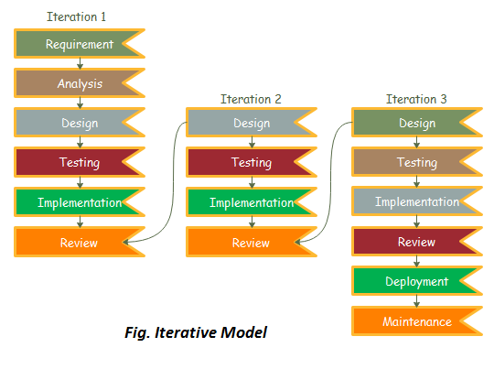

Slide 9
Tools Used
Tools
PHP
GitHub
Web Browser
Purpose
Whole application base creation platform
To manage source code
For Testing

Slide 10
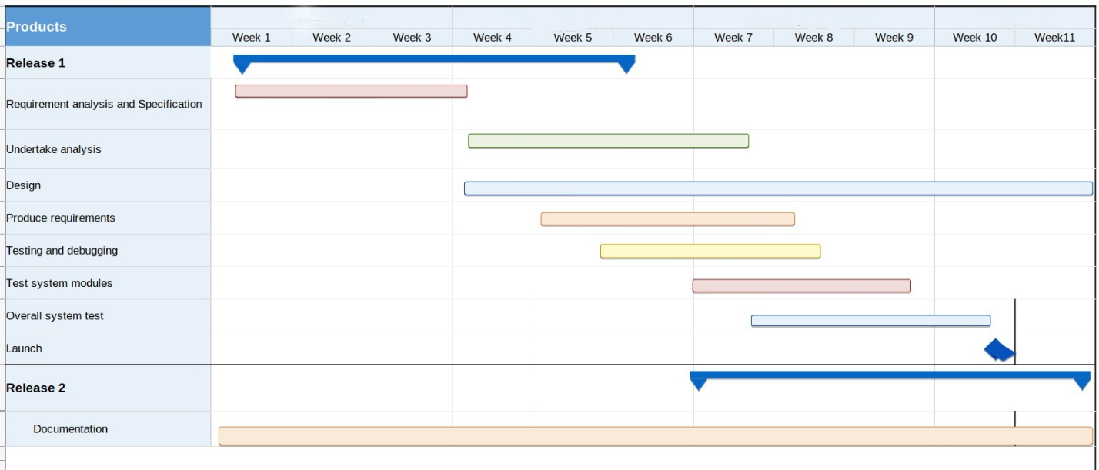
Working Schedule

Slide 11
REFERENCES
Quora. Retrieved from The Pros & Cons of using ZocDoc Answers: https://www.quora.com/What-are-the-pros-and-cons-of-using-ZocDoc-to-make-doctor-appointments
Quora. How-much-do-you-value-reviews-ZocDoc-HealthGrades-etc-versus-a-personal-recommendation-when-selecting-a-doctor https://www.quora.com/How-much-do-you-value-reviews-ZocDoc-HealthGrades-etc-versus-a-personal-recommendation-when-selecting-a-doctor
29 May 2021 . Healthgrades application review https://www.apppicker.com/reviews/12416/healthgrades-app-reviews

Slide 12
THANK YOU

